Slide 2
U.S. Coast Guard Auxiliary: Your Benefits Package

Slide 3
What Type of Benefits Do I Get?
Pride Through Service
Financial
Intellectual
Entertainment and Fellowship
Professional
Safety
Discounts
Memberships
Publications
Banking
Classes
Job Skills
National website: http://hdept.cgaux.org/
Notes:
ICS courses for work

Slide 4
Type of Benefit:
Pride Through Service

Slide 5
Pride Through Service: What Does it Mean to Me?
As a member of the Coast Guard Auxiliary you can take pride in:
Wearing the same uniform as other members of the USCG
Saving a life
Teaching someone something they didn’t know
Serving your community and country
Protecting our ports and waterways from terrorism
Being a part of the Department of Homeland Security

Slide 6
Type of Benefit:
Financial

Slide 7
Financial: What Does it Mean to Me?
Auxiliarists have numerous ways to recognize financial benefits from membership:
National discount programs
Vacation club
Limited Exchange/BX privileges on military installations
USCG Mutual Assistance
OJT Financial Management Education

Slide 8
Financial Benefits: National Partnerships for Discounts

Slide 9
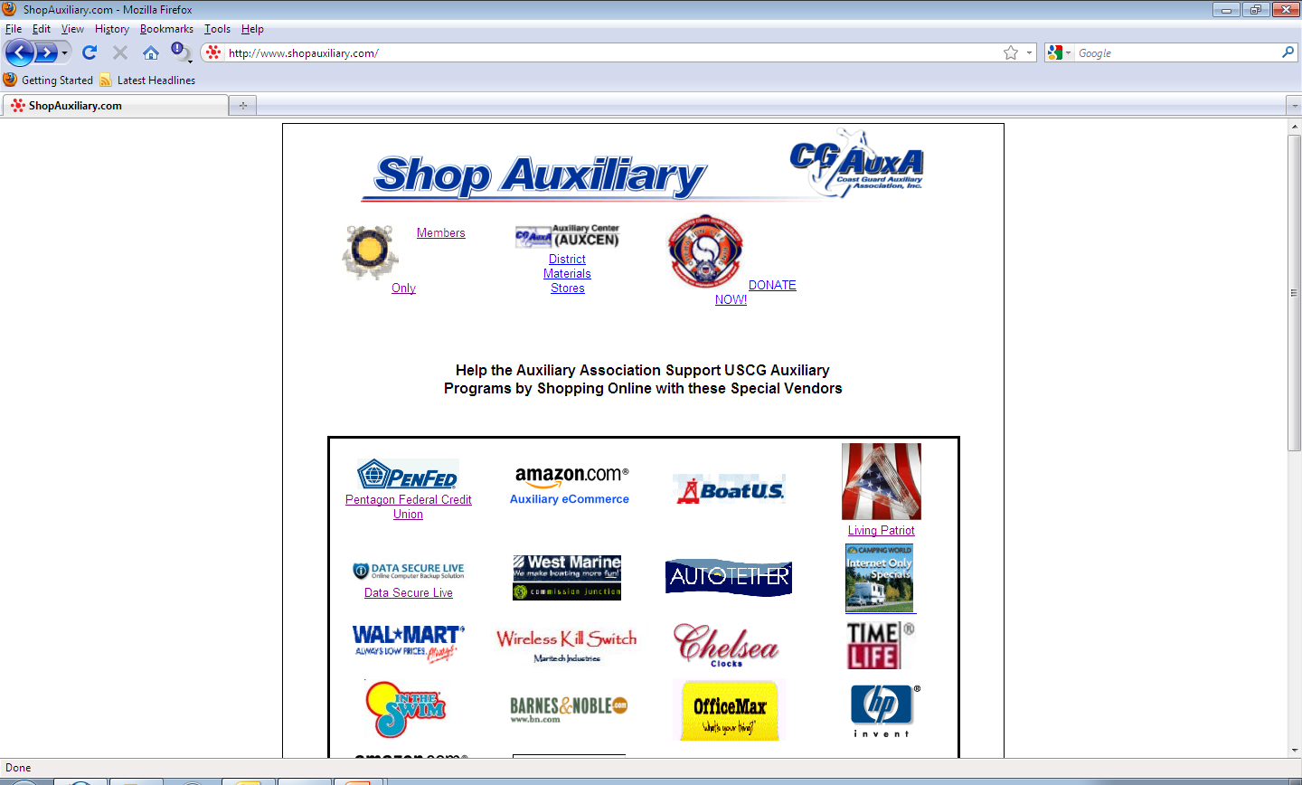
Financial Benefits: How Do I Get Them?

Slide 10
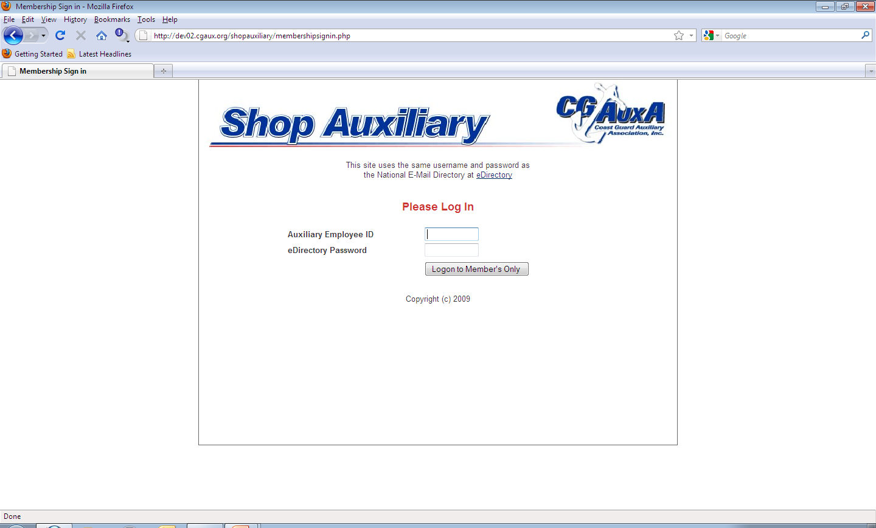
Financial Benefits: How Do I Get Them?

Slide 11
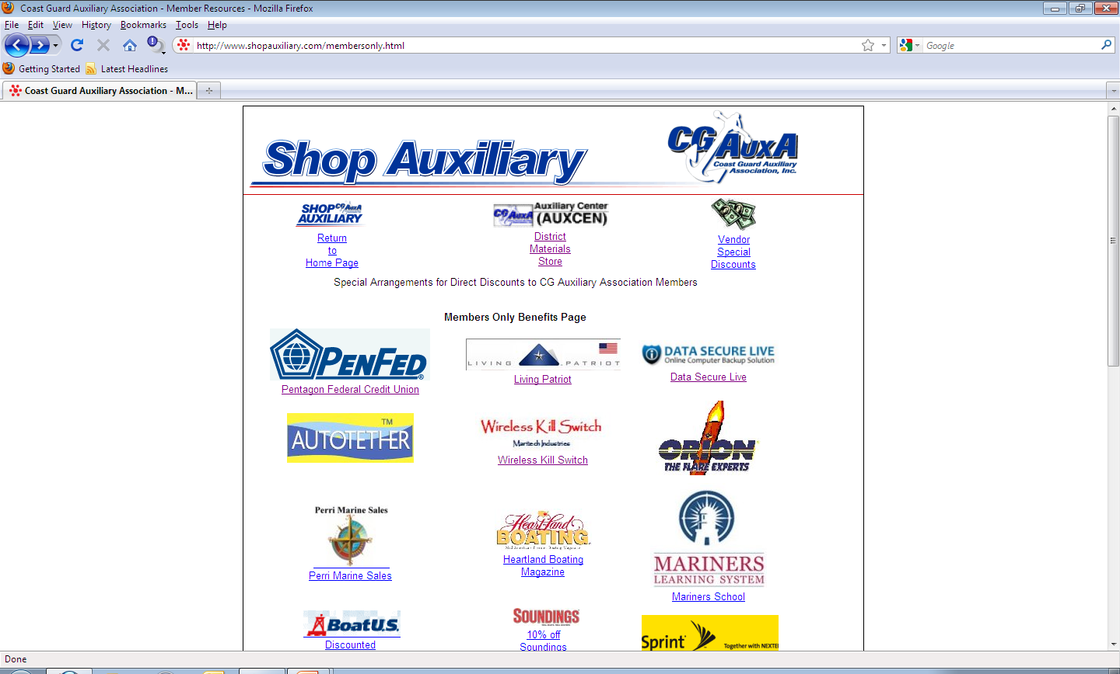
Financial Benefits: How Do I Get Them?

Slide 12
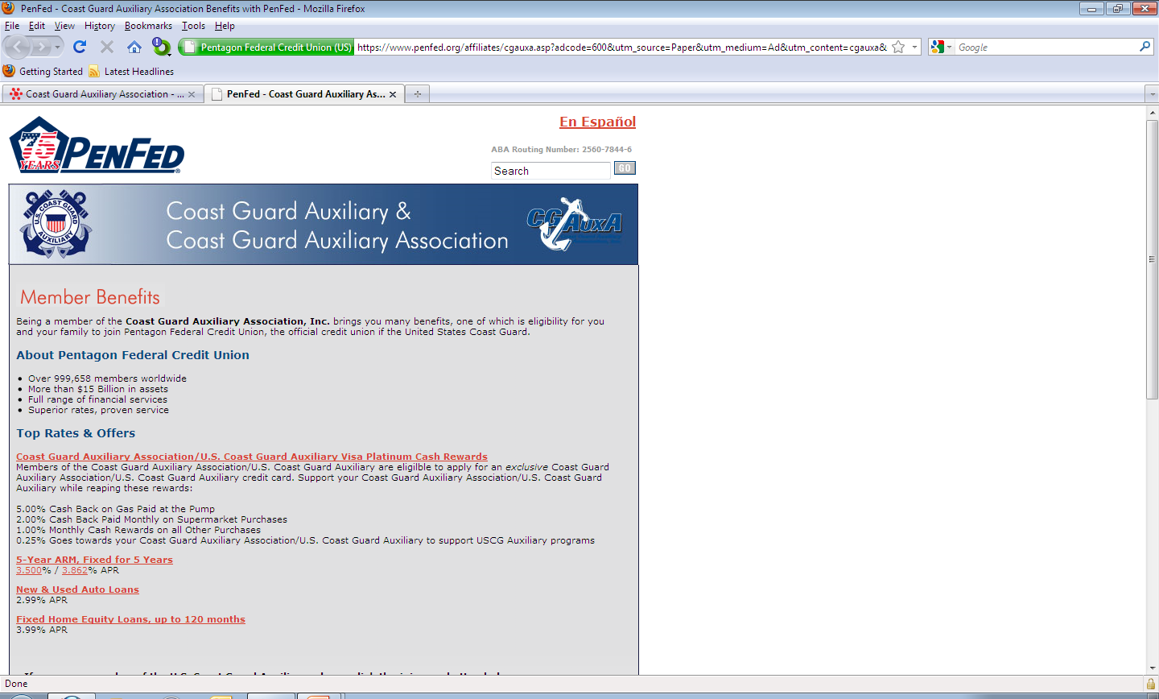
Financial Benefits: How Do I Get Them?

Slide 13
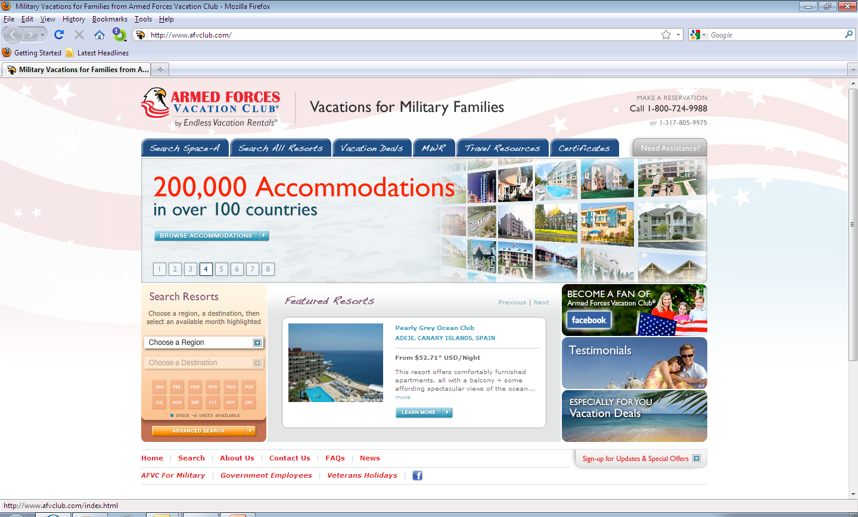
Financial Benefits: Armed Forces Vacation Club

Slide 14
Type of Benefit:
Intellectual

Slide 15
Intellectual: What Does it Mean to Me?
Ever have something you wanted to learn more about? Auxiliarists can learn about:
Weather (AUXOP program)
Boat/Aircraft repair and maintenance
Practical skills (knot tying, boat handling, celestial navigation, etc…)
Government affairs
Financial Management
Parliamentary procedure

Slide 16
Type of Benefit:
Entertainment and Fellowship

Slide 17
Entertainment and Fellowship: What Does it Mean to Me?
As a member of the Coast Guard Auxiliary you can get several entertaining benefits:
4th Cornerstone - Fellowship
After meeting gatherings
Holiday parties
Change of Watch ceremonies
Publications
Navigator
Flotilla/Division publications
Departmental publications
Tours/Participation on various military craft

Slide 18
Type of Benefit:
Professional

Slide 19
Professional: What Does it Mean to Me?
Auxiliarists have a unique opportunity to better their civilian careers by developing skills. Some of those skills may be:
Leadership and Management
C-Schools
Public Education Instructor
ICS/NIMS Training
Financial Management
AUXCHEF
Notes:
C-Schools – IT, PA, Flight, ICS.NIMS – L.E. Careers, FINMAN – Business, AUXCHEF – basic cooking and sanitation

Slide 20
Type of Benefit:
Safety

Slide 21
Safety: What Does it Mean to Me?
Auxiliarists have the opportunity to better their sense of safety and security by taking classes/gaining certifications. Some areas of opportunity may be:
CPR Certification
First Aid Certification
Ability to recognize threats
How to remain constantly alert to surroundings
How to navigate in rough seas
How to find your way home when technology fails

Slide 22
Where My Benefits Come From:
U.S. Coast Guard Auxiliary Association

Slide 23
Where My Benefits Come From: U.S. Coast Guard Auxiliary Association
Is a private non-profit 501(c)3 corporation and shall conduct its fundraising affairs with the utmost sense of propriety and ethics.
Is the vehicle for all national, regional, or broad fundraising initiatives that may benefit the Auxiliary, its units, and its programs. They are responsible for all fundraising efforts in support of Auxiliary activities not funded by the Coast Guard.

Slide 24
Where My Benefits Come From: U.S. Coast Guard Auxiliary Association
The CGAuxA, Inc. is the vehicle for all national, regional, or broad fundraising initiatives that may benefit the Auxiliary, its units, and its programs. They are responsible for all fundraising efforts in support of Auxiliary activities not funded by the Coast Guard.

Slide 25
Where My Benefits Come From: U.S. Coast Guard Auxiliary Association
The Association manages the business of the Coast Guard Auxiliary
Collection of membership dues
Development, printing, sales and distribution of public education courses and materials
Management and staffing of the Auxiliary Center that provides warehousing for materials and goods, shipping and receiving services
Financial management services
Support management services and funding for the Auxiliary National Board, Directorates, Departments and the National Staff

Slide 26
Questions and Comments

Slide 27
Presented By: Chris Greulich, DVC-HR
N-TRAIN 2011
St. Louis, MO
Under direction and authority of:
Joseph G. O’Leary, DIR-H
© 2011 by United States Coast Guard Auxiliary Association, Inc.

