Slide 1
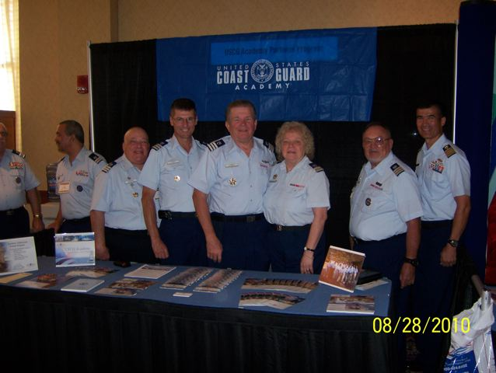
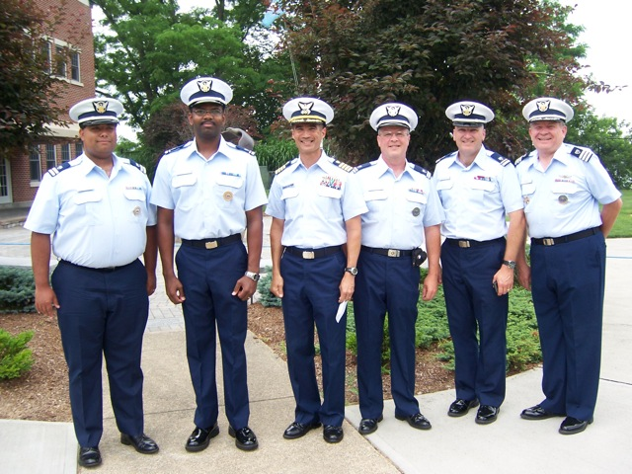
DIVISION
ACADEMY - AIM
UNITED STATES COAST GUARD
AUXILIARY
READINESS SUPPORT FORCECOM
NATIONAL DEPARTMENT OF HUMAN RESOURCES
JOE OLEARY – DIRECTOR
JOHN JOHNSON – DIVISION CHIEF
J
ACADEMY PARTNERS PROGRAM
NEW LONDON,CT

Slide 2
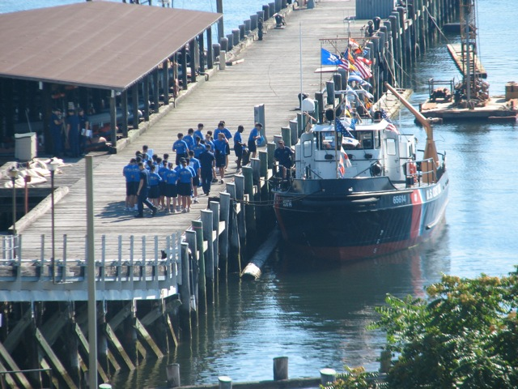
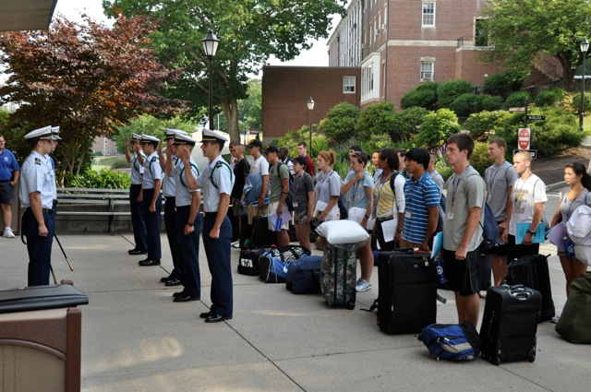
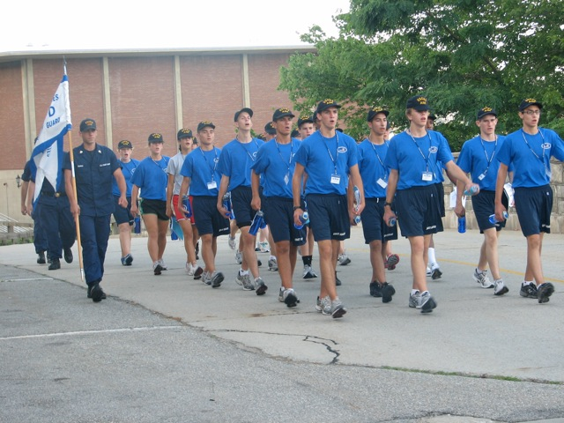
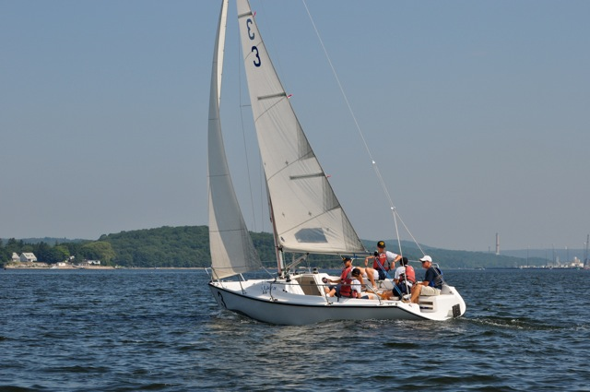
ACADEMY INTRODUCTION MISSION

Slide 3
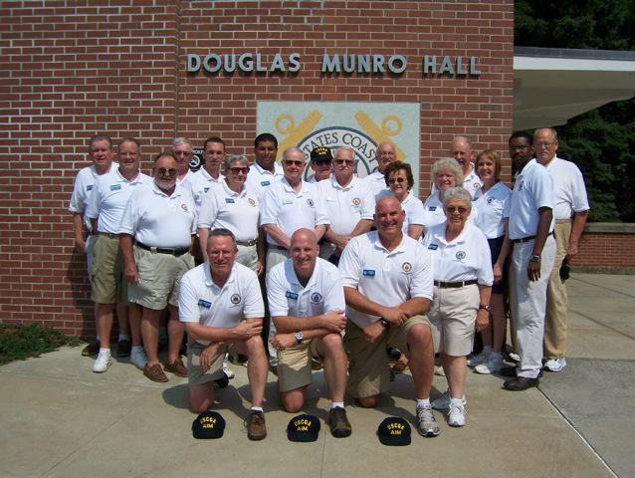
ACADEMY ADMISSIONS PARTNERS

Slide 4
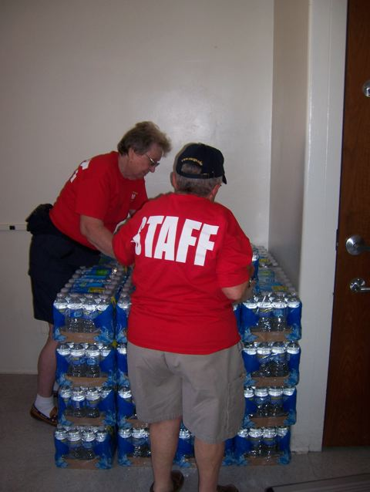
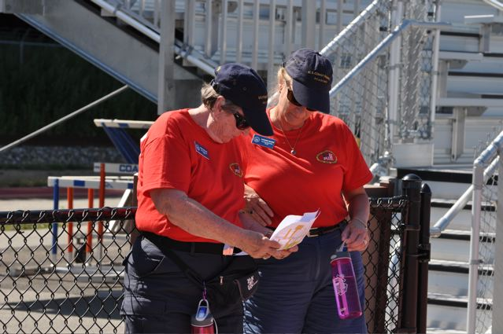
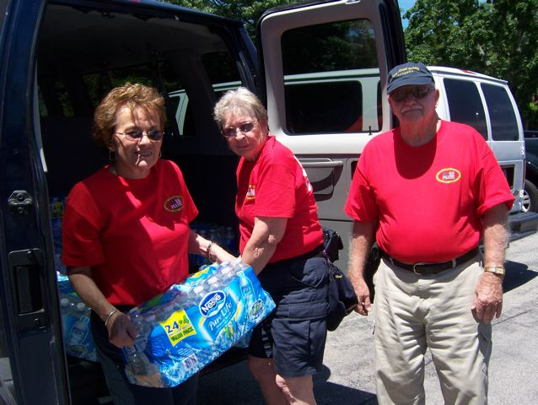
ACADEMY LOGISTICAL SUPPORT

Slide 5
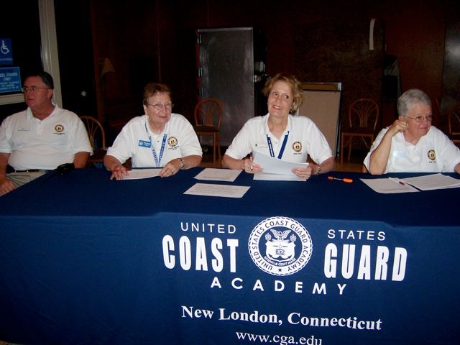
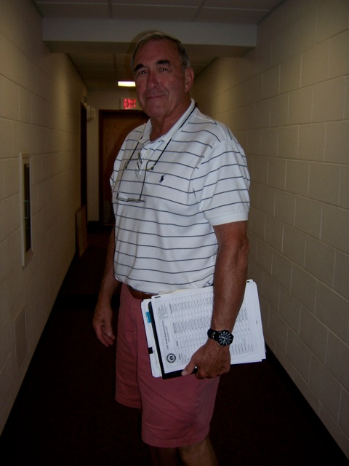
ACADEMY MEDICAL SUPPORT

Slide 6
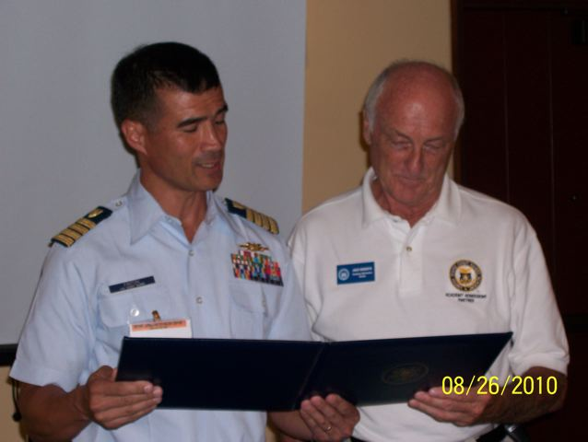
ACADEMY RECOGNITION (PARTNERS)

